Slide 1
Zendesk Upgrade
RM Training Guide
June 2018

Slide 2
Agenda
Objective
Why the upgrade
Process overview
Application overview
  With Macros
Guide : Help Center

Slide 3
Objectives
Understanding of our existing Raw material processes
Understanding of how the application works based on our processes
Awareness of Support (Help Center Guide)

Slide 4
Why the Upgrade
Enterprise Plan

Slide 5
Why the Upgrade
Easy to use (no corrupted workflows)
No customization
Low maintenance
  ( don’t need Nathalie Harvey & Ashley Peterson to cancel your tickets)
User friendly, based on our existing processes
Agile( flexible , not ridged )

Slide 6
Business Processes
Raw material

Slide 7
Our Raw Material Processes
Create new raw material customer : Canada
Create new raw material customer : USA
Inside Tank Request: Canada
Inside Tank Request : USA
Close Account
Account changes(AX)
Reactivations
Add/Remove Service
Maintenance Container
Frequency Change
Rep Request
Transport Inquiry
Promo Request
Notes:
Briefly remind everyone about all the raw material processes, no need to go into all of them just as a friendly reminder

Slide 8
Other Related Processes
Customer Complaint
CSD (customer service dispatch )
Create new Finished Good customer
Inbox Customer Service
Inbox Revenue Assurance (pfs)
Onboarding
Returned Mail
Notes:
Other related processes affected by the change in Zendesk but not impacting them directly

Slide 9
Implicated Roles/Functions RACI
Procurement Reps - Accountable & Responsible for Customer information
Customer Service Agents - Responsible for Customer information
RM Sales Support- Responsible for system input & ensure assumptions correct
Master Data – Accountable for system entry accuracy, validate against agreement
Revenue Assurance – Consulted to ensure pricing is created and maintained correctly
Transport (Dispatchers & Admin) – Responsible to ensure services are set & executed
Tech Support (Container Mgmt.) - Responsible to ensure equipment is correct
Accounts Receivable – Informed to ensure invoicing is setup right and issues contact
Customer Service Dispatch –Responsible to communicate customer information to Transport
Notes:
Important for them to understand their role & responsibilities

Slide 10
Raw Material process
What is Reactivation?
  How does it differ from new raw material customer within Sanimax?
    Reactivation means it’s a customer returning to Sanimax
    Their account ALREADY exists in our Financial System
What is Removing a Service ?
  How does it differ from closing an account ?
    Customer may have several services with us, if removing a service it is NOT closing the account
Adding a Service?
  What does it mean ?
    Customer is active with Sanimax , has services with us & just wants to add another service. This is not a NEW account
Account changes
  When do we use this ?
    Customer wants to modify address/telephone #/grammar correction in their name //email address//link accounts
Notes:
The processes that seem most to be the most problematic // just lets emphasize the difference between them

Slide 11
Case scenarios :
Existing Tier 3 (USA /Canada ) customer called customer service . Has grease service with us but now wants to add trap service. What happens ?
    CSA opens a ticket “ rep request”
Existing Tier 2 customer wants to close his trap service with us . The customer calls the sales rep directly . How do we proceed ?
    Rep tries to retain the customer but if cannot proceeds to open a Zendesk ticket “Add or Remove service”
Notes:
Tier 3 , depends if any US representation is within the class. Same applies to Canada

Slide 12
Case scenarios :
Tier 3 customer calls contact center wants to close account. What happens next if you are in the USA ? IN Canada ?
    USA: CSA opens a “rep request”
    Canada: CSA proceeds to “ close account”
Tier 2 customer contacts sales rep , wants to order SanEcotanks. What happens next ? Who takes care of what in order to make it happen ?
    Sales rep proceeds to create a sales quotation , once accepted with customer , creates an “Inside Tank Request”

Slide 13
Application Overview
Zendesk

Slide 14
What is changing
What are the changes :
Will no longer be using the left side of your screen but using the bottom center of your screen , where you have the macro
The macros available to you are based on your role within the process which means
  You will only see the macros that are available for your role
  The workflows in Zendesk represent our raw material processes
If you make a mistake , you can easily correct it but removing the macro & applying the correct one

Slide 15
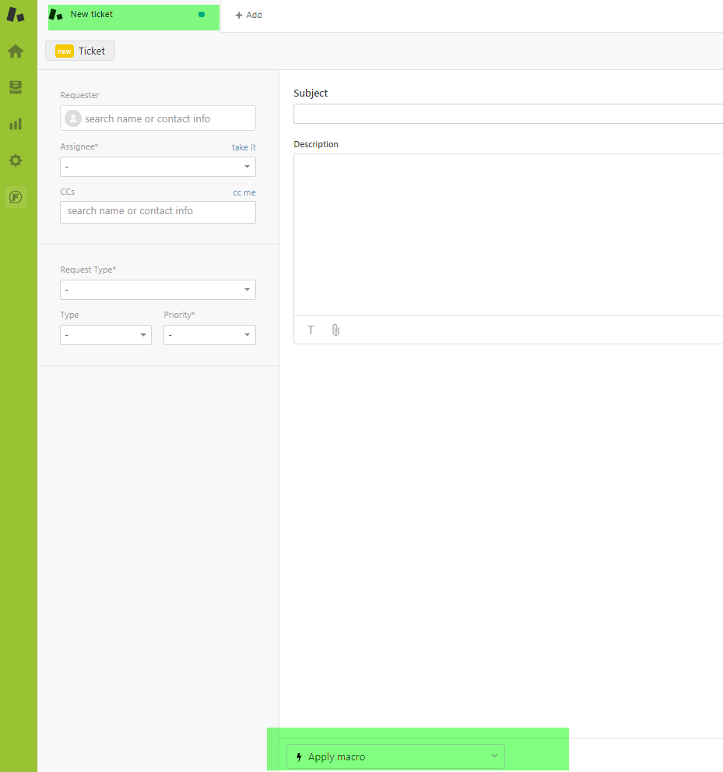
Application
This is where you start pick the right macro
Notes:
Open up sandbox & do with the class how to create a new ticket ( follow through with the next couple of slides)

Slide 16
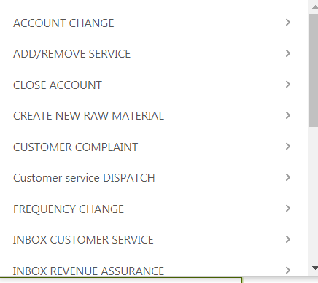
Choose your request type
Notes:
Do it live within sandbox with the class

Slide 17
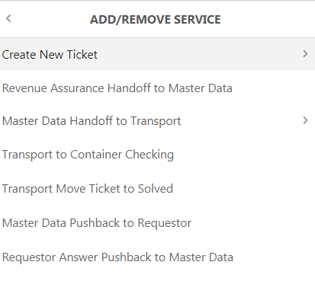
Choose what action you want to do
Notes:
Do it live within sandbox with the class

Slide 18
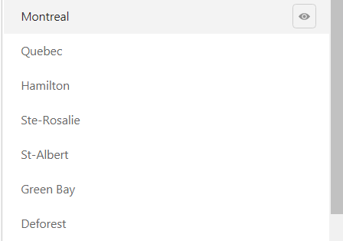
Choose the location
Place your mouse over the eye
Notes:
Do it live within sandbox with the class and show them how to preview a macro ( using the eye)

Slide 19
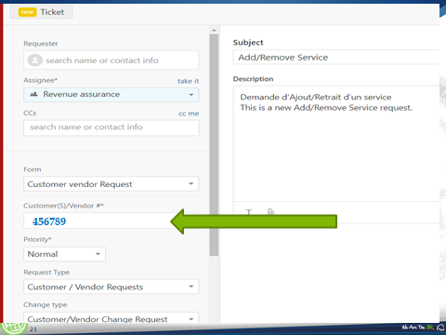
Customer number
Notes:
Emphasize the only time you go on the left hand side is for the customer number

Slide 20
EXERCISES
remove a service
    Please proceed with the Zendesk ticket
Customer has issues with his container
    What request type ( workflow ) will you use in Zendesk
Tier 2 customer calls contact center , has a question on pricing
    Which request type/workflow will you create in Zendesk
Sales Rep wins back old customer .
    What is the raw material process associated to this /which workflow type do you use in Zendesk
Notes:
For each case need to create the ticket in Zendesk , using the sandbox environment & depending who is in the class , try to finish off the workflow until the end ( complete it)
If you have time you can do all of them // but at least 2 of them

Slide 21
Important Notes
Always use macros, bottom of your screen
Left hand side of your screen is there just to add the customer number & guide you as to where the ticket is going , which group , what workflow step & location, but you do not change anything here
Push backs – the existing procedure does not change. You still need to add an assignee
Sales Support –you still need to add a “location” when a ticket is generated by the rep via email
Cancelling tickets -you will have access to a macro “request to cancel ticket” which once submitted will go to a specific group that will take care of the request
Notes:
After you finished doing the exercises , come back to this slide as a recap

Slide 22
Zendesk GUIDE
Help Center

Slide 23
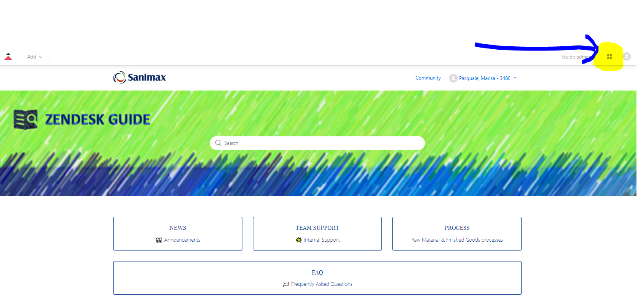
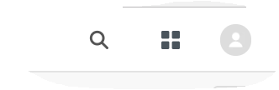
When you click on this icon , you will get then screen below
Notes:
Continue within sandbox & show the class how to access GUIDE , then go ahead & click on Process , to show them where they can obtain the information to help them ( job aids already included in this document , processes visios, guidelines etc..

Slide 24
Appendix
Job aids

Slide 25
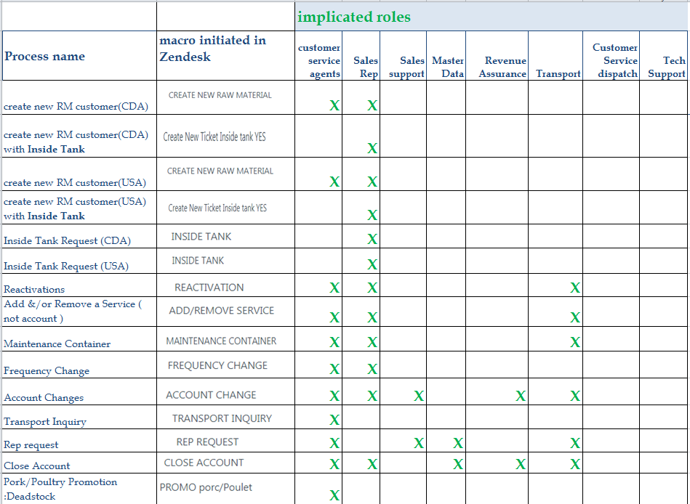
New ticket

Slide 26
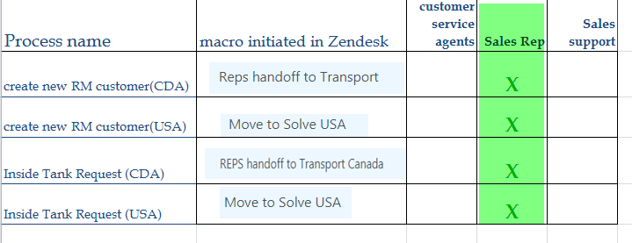
Sales Rep jO

Slide 27
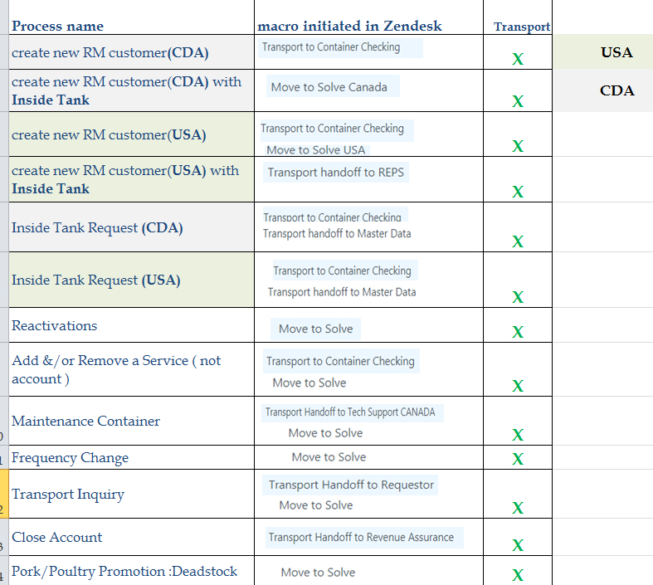
Transport

Slide 28
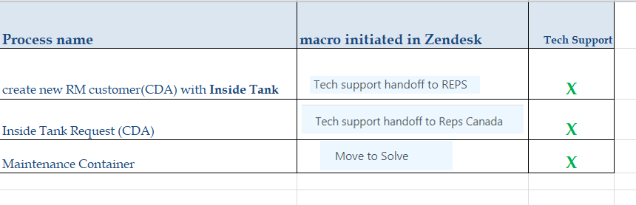
Tech Support

Slide 29
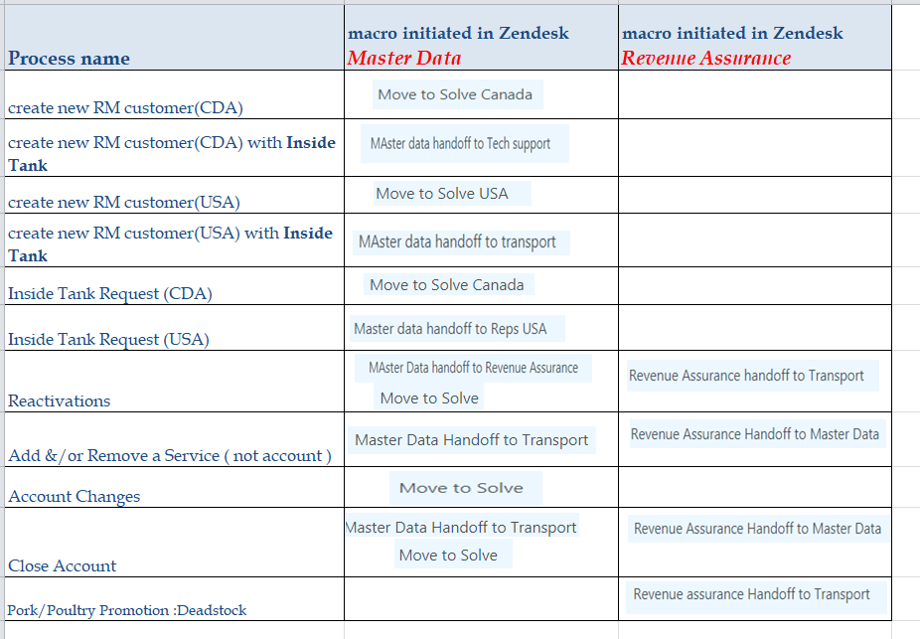
Master Data & Revenue Assurance

Slide 30
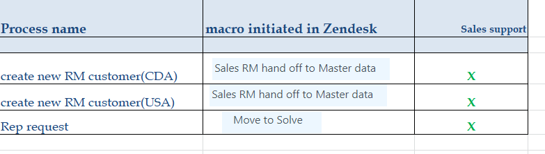
Sales Support

