Slide 1
Zendesk Upgrade FG Training Guide
June 2018

Slide 2
Agenda
Objective
Why the upgrade
Application overview
With Macros
Guide : Help Center

Slide 3
Objectives
Understanding of our existing processes
Understanding of how the application works based on our processes
Awareness of Support (Help Center Guide)

Slide 4
Why the Upgrade
Enterprise Plan

Slide 5
Why the Upgrade
Easy to use (no corrupted workflows)
No customization
Low maintenance
( don’t need Nathalie Harvey & Ashley Peterson to cancel your tickets)
User friendly, based on our existing processes
Agile( flexible , not ridged )

Slide 6
Business Processes
Finished Goods

Slide 7
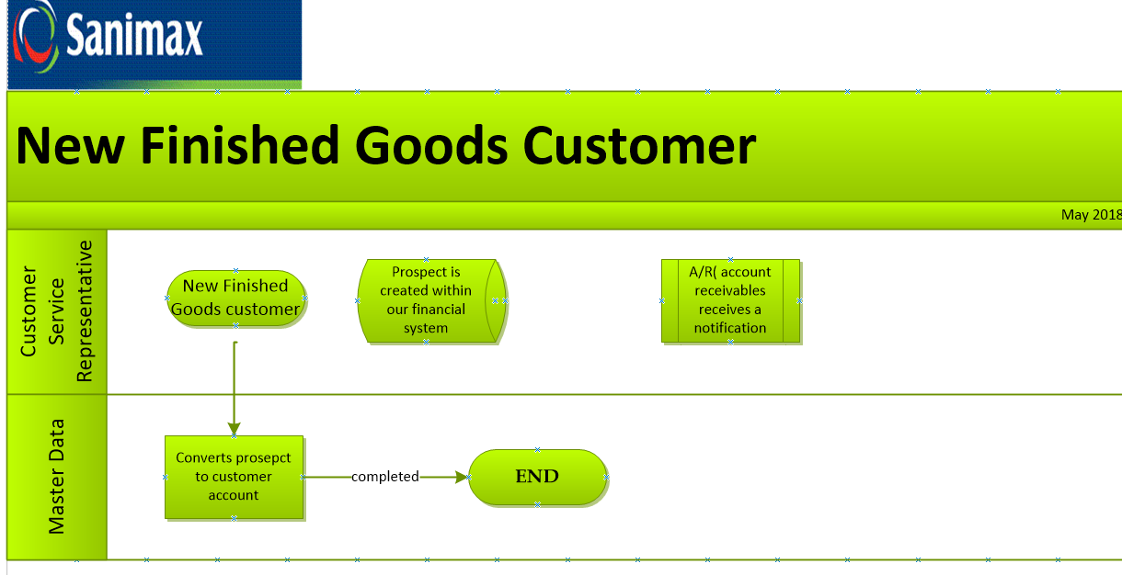

Slide 8
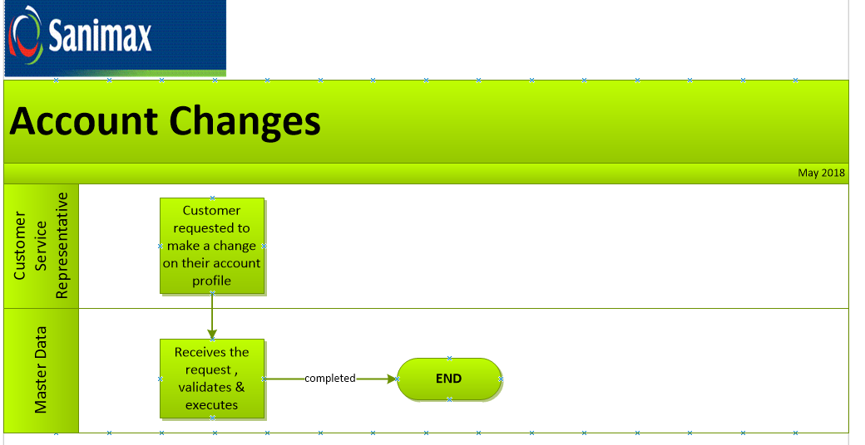

Slide 9
Our Raw Material Processes
Create new raw material customer : Canada
Create new raw material customer : USA
Inside Tank Request: Canada
Inside Tank Request : USA
Close Account
Account changes(AX)
Reactivations
Add/Remove Service
Maintenance Container
Frequency Change
Rep Request
Transport Inquiry
Promo Request
Notes:
Briefly remind everyone about all the raw material processes, no need to go into all of them just as a friendly reminder

Slide 10
Other Related Processes
Customer Complaint
CSD (customer service dispatch )
Create new Finished Good customer
Inbox Customer Service
Inbox Revenue Assurance (pfs)
Onboarding
Returned Mail
Notes:
Other related processes affected by the change in Zendesk but not impacting them directly

Slide 11
Case scenarios :
Customer calls to have a new billing account created, what happens next?
CSR creates the prospect and opens a Zendesk ticket : Request type - New FG customer and links the account to existing account if necessary
What is the process at Sanimax for a new finished goods customer?
CSR creates the prospect , opens a Zendesk ticket :request type New FG customer
Existing customer wants to have his address changed? How do you proceed to make these changes ?
CSR opens ticket : Request type : Account Changes
Notes:
Tier 3 , depends if any US representation is within the class. Same applies to Canada

Slide 12
Application Overview
Zendesk

Slide 13
What is changing
What are the changes :
Will no longer be using the left side of your screen but using the bottom center of your screen , where you have the macro
The macros available to you are based on your role within the process which means
You will only see the macros that are available for your role
If you make a mistake , you can easily correct it but removing the macro & applying the correct one

Slide 14
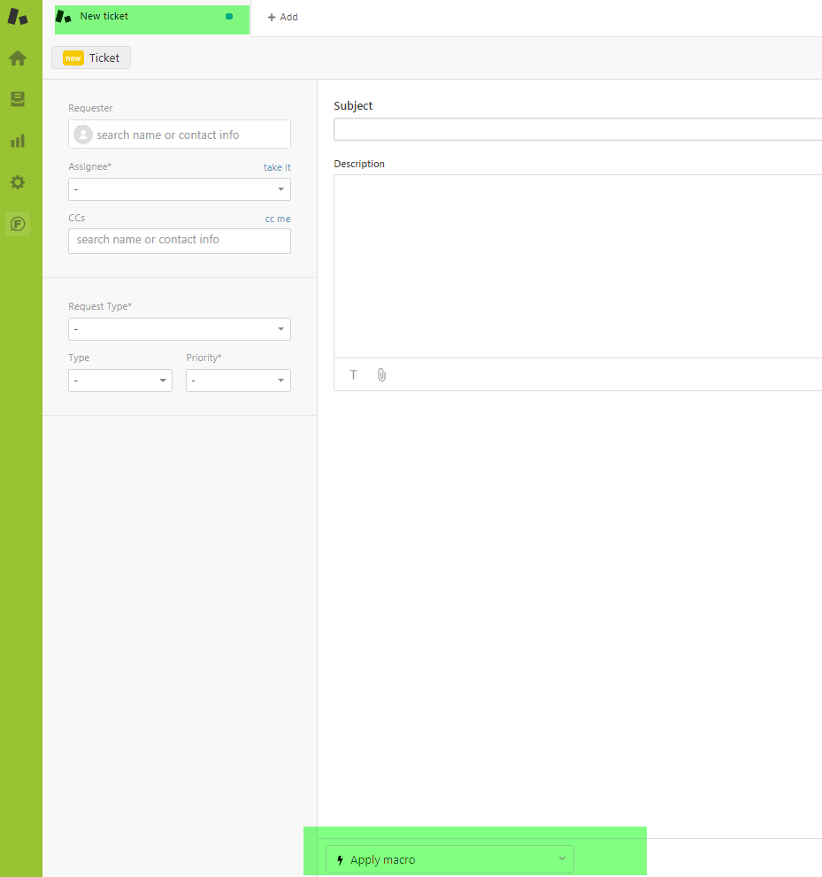
Application
This is where you start pick the right macro
Notes:
Open up sandbox & do with the class how to create a new ticket ( follow through with the next couple of slides)

Slide 15
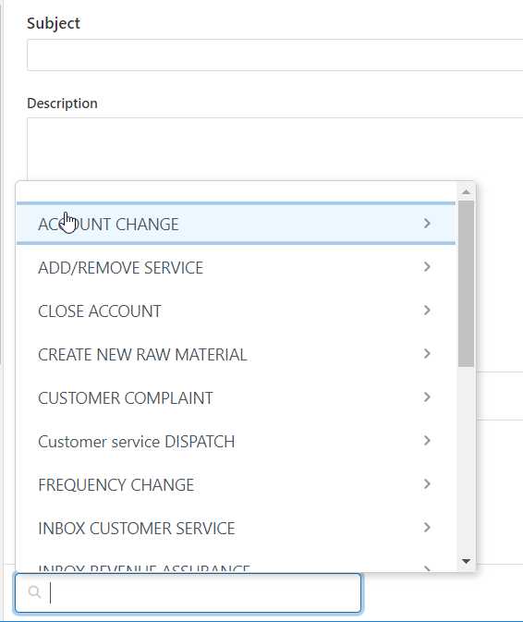
Pick your request type
Notes:
Open up sandbox environment & show the class , do together how to create a new FG customer

Slide 16
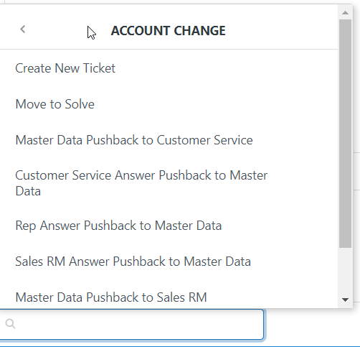
Pick this macro to create ticket

Slide 17
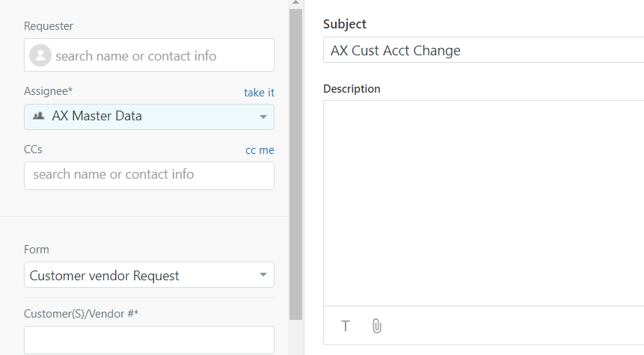
It will show you where the ticket will go to
In this section “description” you indicate what you would usually write , please indicate the prospect account number on the left hand side and then submit the ticket
You need to write the account number
987456

Slide 18
Important Notes
Always use macros, bottom of your screen
Left hand side of your screen is there just to add the customer number, nothing else
Push backs – the existing procedure does not change. You still need to add an assignee
Notes:
After you finished doing the exercises , come back to this slide as a recap

Slide 19
Zendesk GUIDE
Help Center

Slide 20
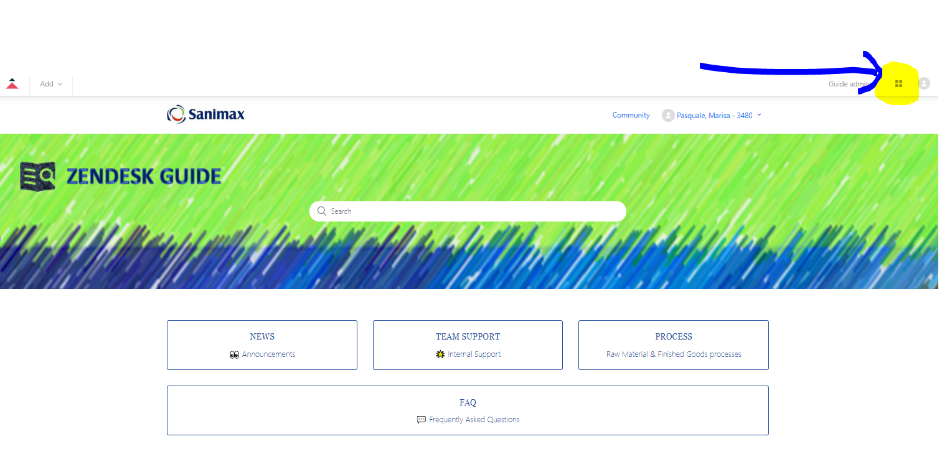
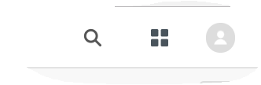
When you click on this icon , you will get then screen below
Notes:
Continue within sandbox & show the class how to access GUIDE , then go ahead & click on Process , to show them where they can obtain the information to help them ( job aids already included in this document , processes visios, guidelines etc..

